Slide 1


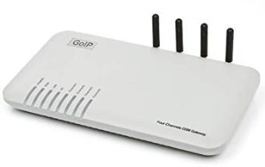

Bonrix Voice Call
Bonrix Software Systems
http://www.bonrix.net/
http://www.bonrix.co.in/

Slide 2
Voice Call Web Panel
Voice Call Web Panel Simplify The Calling Function.
Using Voice Call Web Panel User Can Use Calling Function By Various Platforms like VoIP Devices, SIP Professional Voice Call Manager Software etc.
Voice Call Web Panel Provide Various Calling Way Like Quick Call, Group Call, CSV Call By Simply Uploading an Audio File Of Any Formats.
Voice Call Web Panel Also Provide Date Vise Calling Summary And Calling Report As Well.

Slide 3

Web Panel To VoIP Device Call
Call Direction
VoIP Device
Bonrix Voice Call
Response Direction
Network

Slide 4
Web Panel To Software Call
Call Direction
SIP Prof.
Software
VoIP Device
Bonrix Voice Call
Response Direction
Network

Slide 5
Bonrix Voice Broadcast Web Panel Description
Description Bonrix Voice Broadcast Web Panel provides facility for only voice campaign for marketing purposes and also for transnational purpose for voice notification and Alert as well as OTP notification on voice call.
This web provide re-seller option for selling voice call for voice marketing purpose.
Android app also available for Bulk Voice campaign from android phone.

Slide 6
Bonrix Voice Broadcast Web Panel Use Cases
Admin Panel :
1. Overall management and voice campain routing - re-seller management, pricing and tariff management.
Re-seller Panel :
1.User creation, User management , Credit allocation, reporting.
User Panel:
1.Voice broadcasting, Voice sms, running voice marking campaign, upload pre-recorded audio file, upload bilk contact using Excel /CSV, Checking Voice report.

Slide 7
Different Type Of Voice Termination
SIP - VOIP telephony provider connector.
USB-3G data card dongle based voice to GSM dialer.
GSM/3G Void GSM Gateway.
Third party HTTP API for Voice and FTP audio file upload.
Android app also available for Bulk Voice campaign from android phone.
Voice API is also available for third party external software integration

Slide 8
SIP Professional Voice Call Software
  Bonrix VoIP SIP is developed for outbound call center for processing leads via different types of VoIP Gateway.
  It is developed for automated calling from desktop based phone working on different VoIP based technology

Slide 9
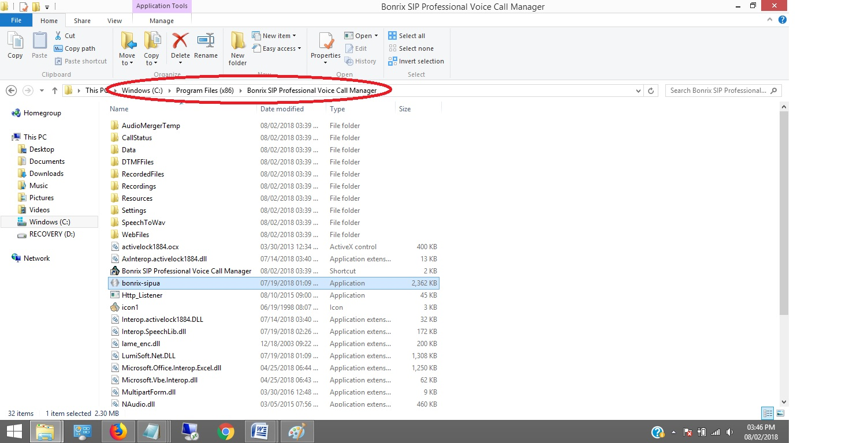
SIP Professional Config.
Step 1: After installation of Voice call messenger user need to redirect Program files > Bonrix SIP Professional Voice call manager.

Slide 10
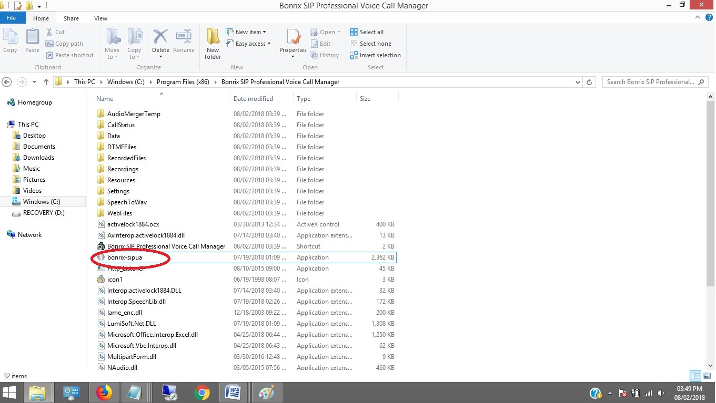
SIP Professional Config.
Step 2: User have to double click on bonrix-sipua.

Slide 11
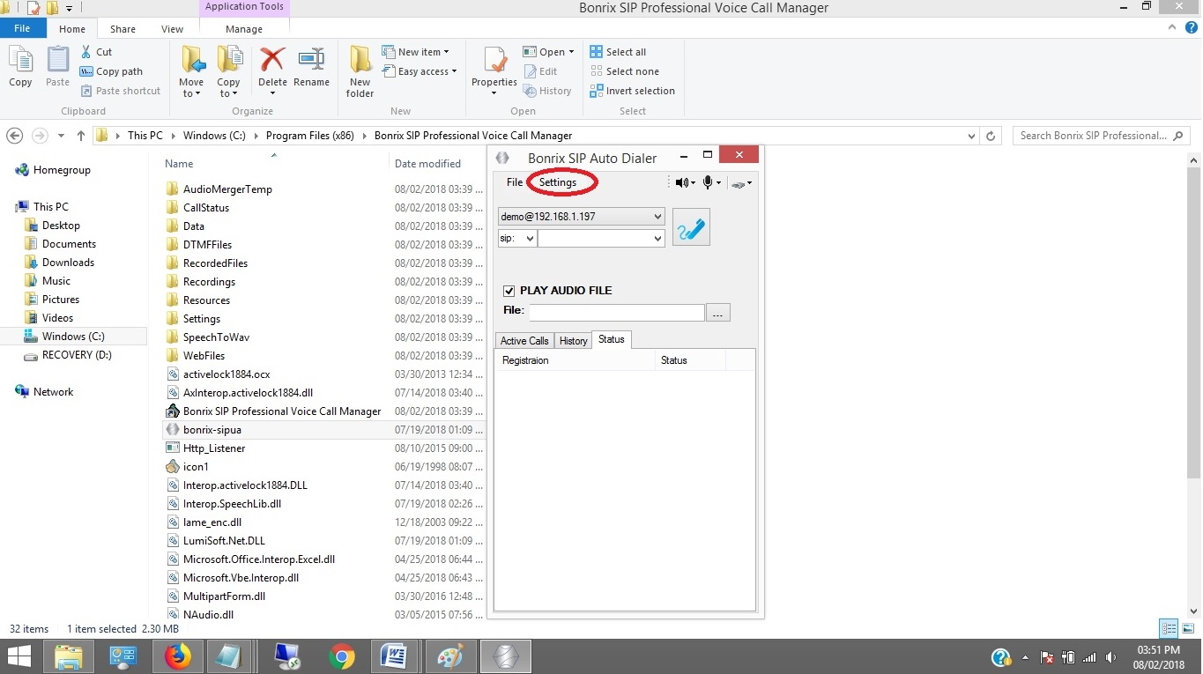
SIP Professional Config.
Step 3: After double click on bonrix-sipua User can see Bonrix SIP Auto Dialer software go to settings.

Slide 12
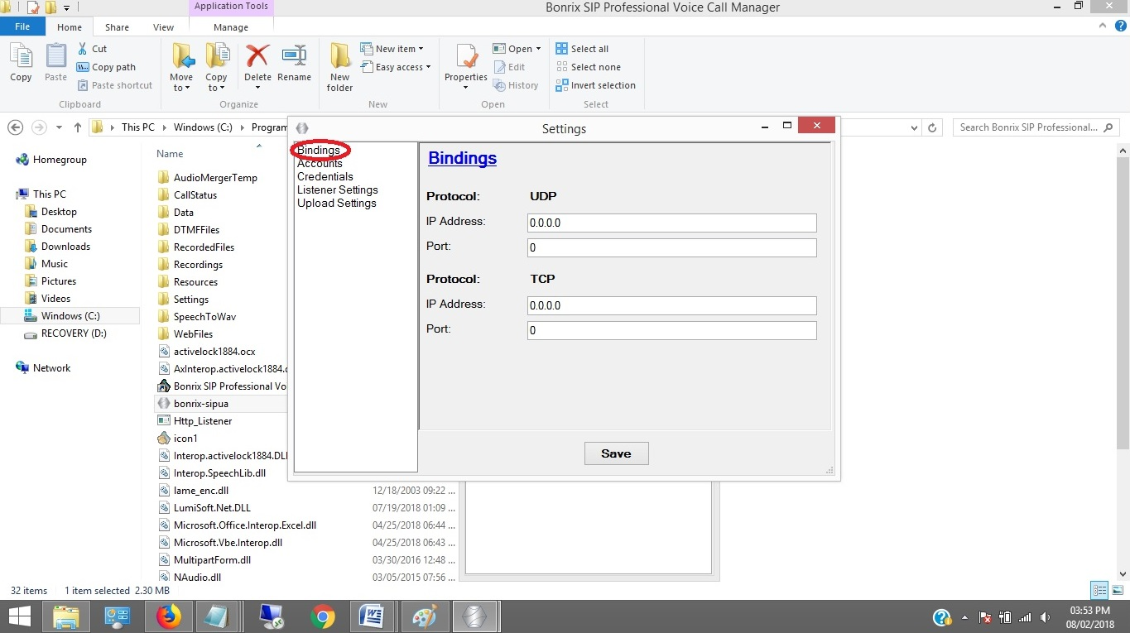
SIP Professional Config.
Step 4: In setting go to Bindings panel and set IP as shown in below screenshot.

Slide 13
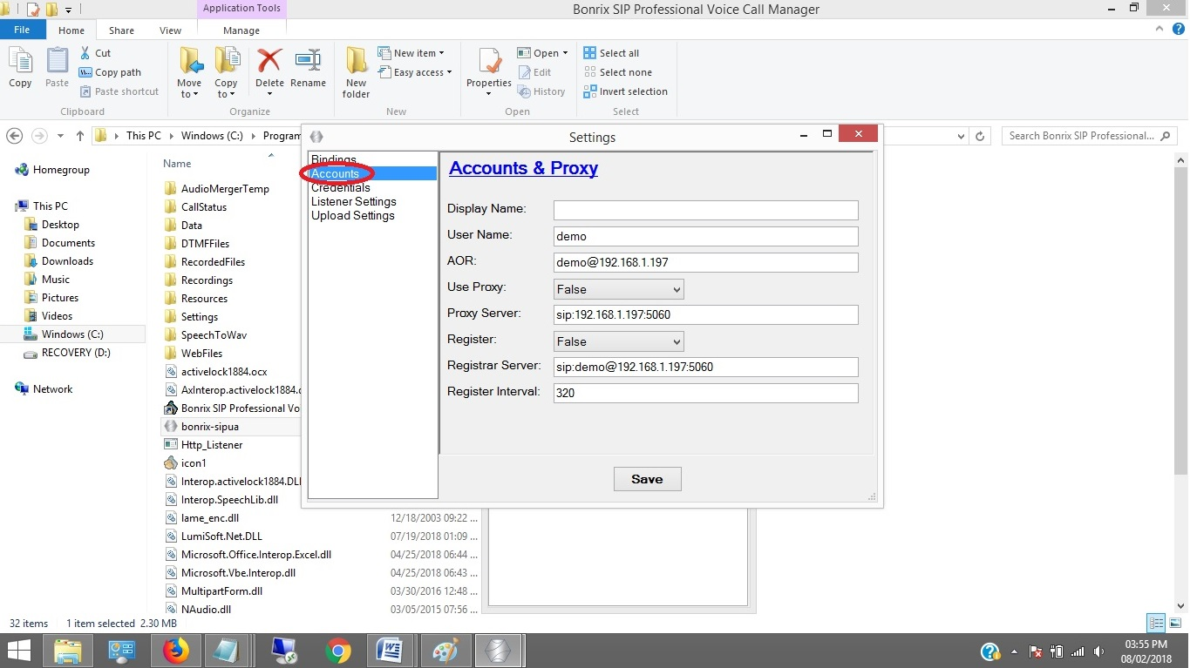
SIP Professional Config.
Step 5: Go to Accounts panel and set User name, AOR, User Proxy, Proxy Server, Register, Registrar Server, Register Interval as shown in below screenshot.

Slide 14
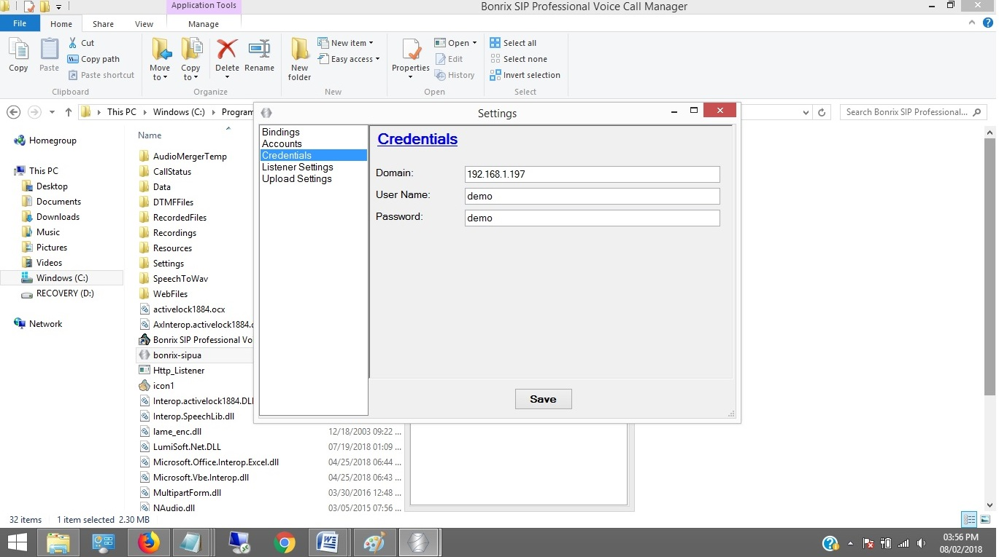
SIP Professional Config.
Step 6: Go to Credentials and set Domain, User Name, Password as shown in below screenshot.

Slide 15
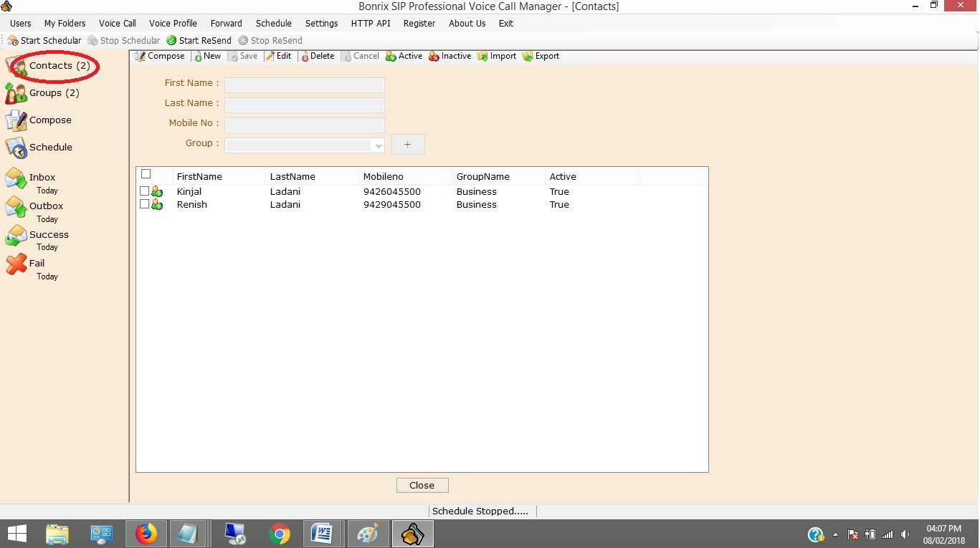
SIP Professional Config.
Step 7: Open Bonrix SIP Professional and go to Contacts panel then enter First, Last Name, Mobile no as shown in below screenshot.

Slide 16
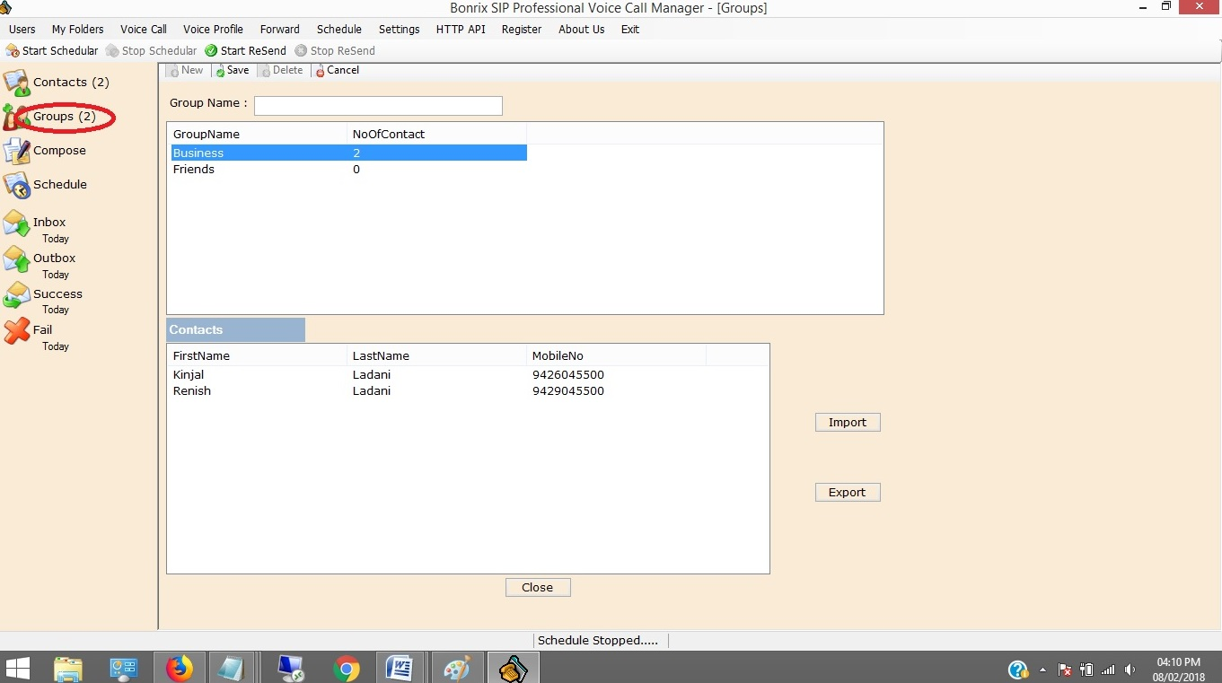
SIP Professional Config.
Step 8: go to Groups panel then click on new button and create group as shown in below screenshot. You can Import and Export by clicking on Import & Export button.

Slide 17
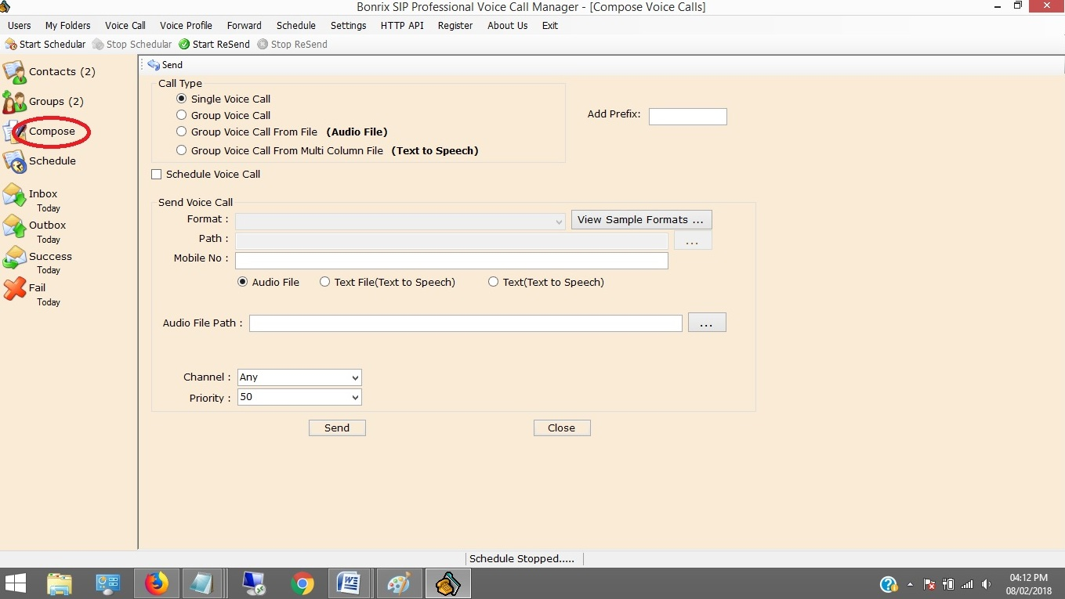
SIP Professional Config.
Step 9: Go to Compose Panel and select your call type as per your choice Single, Group Voice Call, Group voice call from file and from Multi Column file.

Slide 18
VoIP Devices For Voice Call
  A VoIP Devices uses voice over IP technologies for placing and transmitting
  transmitting telephone calls over an IP network, such as the Internet , instead of the
  traditional public switched telephone network (PSTN).
  Digital IP-based telephone service uses control protocols such as the Session Initiation Protocol (SIP), Skinny Client Control Protocol (SCCP) or various other proprietary protocols.
  A VoIP telephone consist of the hardware and software components.
The software requires standard networking components such as a TCP/IP network stack, client implementation for DHCP, and the Domain Name System (DNS).

Slide 19
Several Models of GoIP GSM-gateways
There Are Various Models of GoIP GSM-gateways.
  1 Port GSM VoIP Gateway,
  4 Port GSM VoIP Gateway,
  8 Port GSM VoIP Gateway,
  16 Port GSM VoIP Gateway,
  32 Port GSM VoIP Gateway,
  64 Port GSM VoIP Gateway

Slide 20
Applications of GoIP gateways
They are vastly usable by system integrators, TCP, call-centers, large and little companies and domestic users of VoIP as well.
Adding the mobile lines in the existing telephone system Organization of outbound call-centers Call transfer from GSM into SIP and backward.
GoIP provides GSM network between telephone systems and IP PBX,
and ensures the fast connection to PSTN where usual telephone lines
are unavailable.

Slide 21
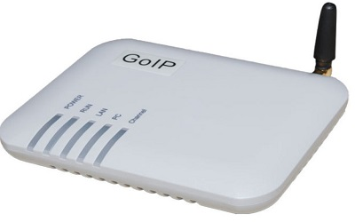
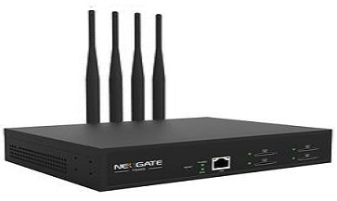
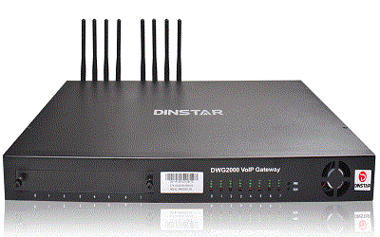
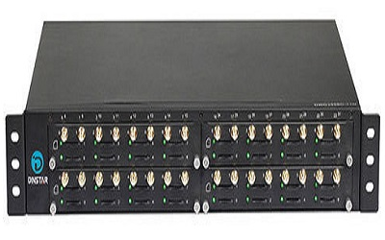
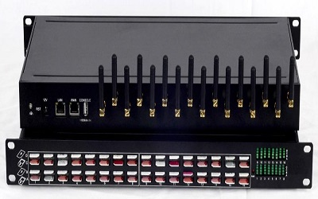
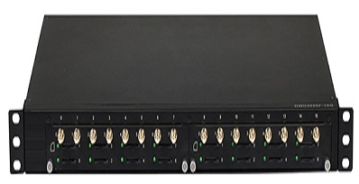
GoIP gateways
4 -Port
8 -Port
1 -Port
32 -Port
16 -Port
64 -Port

Slide 22
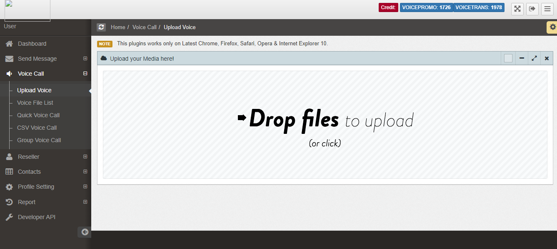
Bonrix Voice Functions
1 : Upload Voice File:

Slide 23
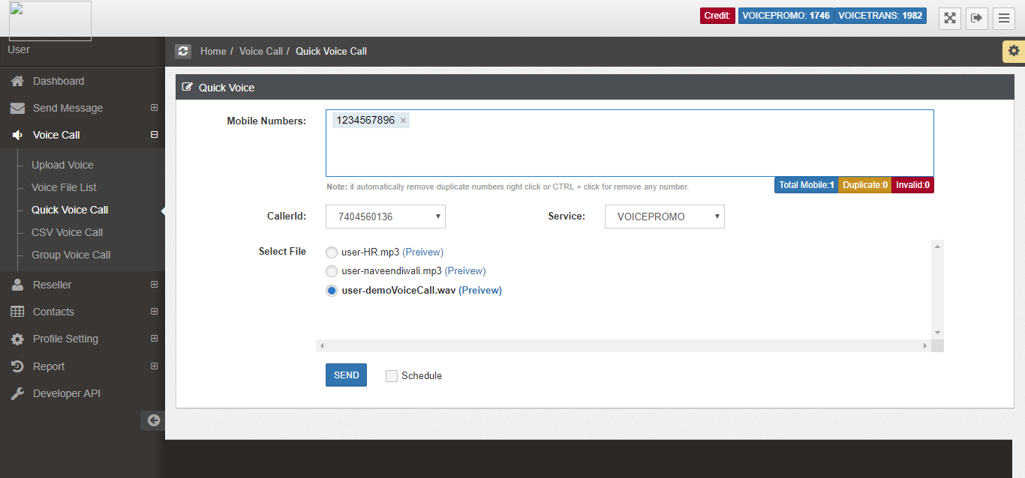
Bonrix Voice Functions
2 : Quick Voice Call:

Slide 24
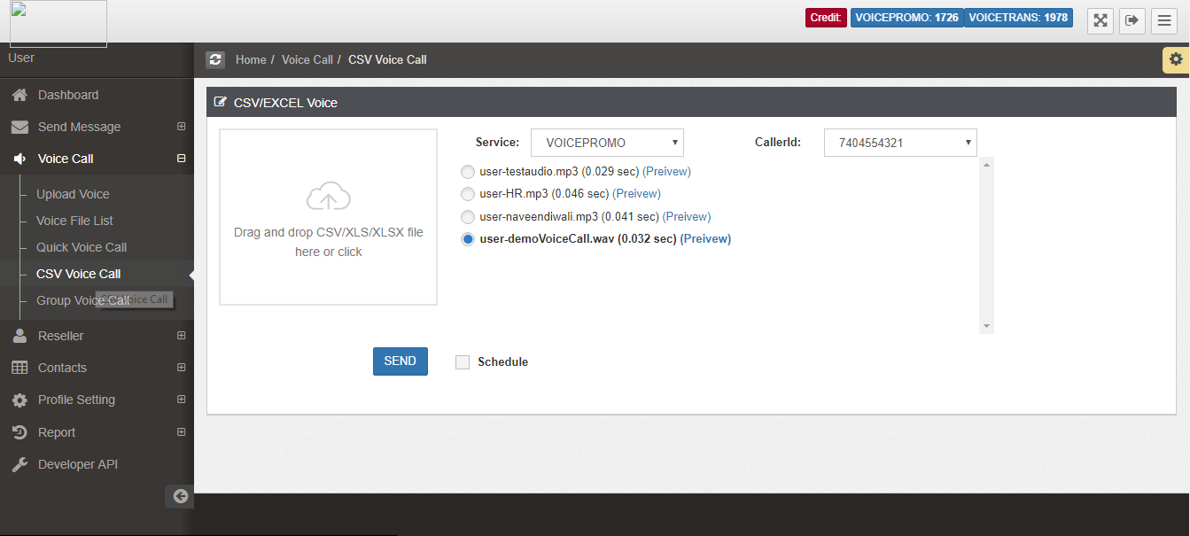
Bonrix Voice Functions
3 : CSV Voice Call:

Slide 25
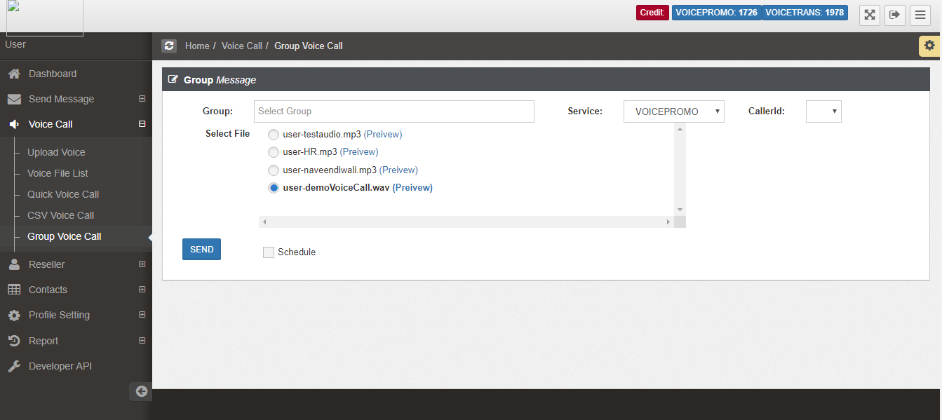
Bonrix Voice Functions
4 : Group Voice Call:

Slide 26
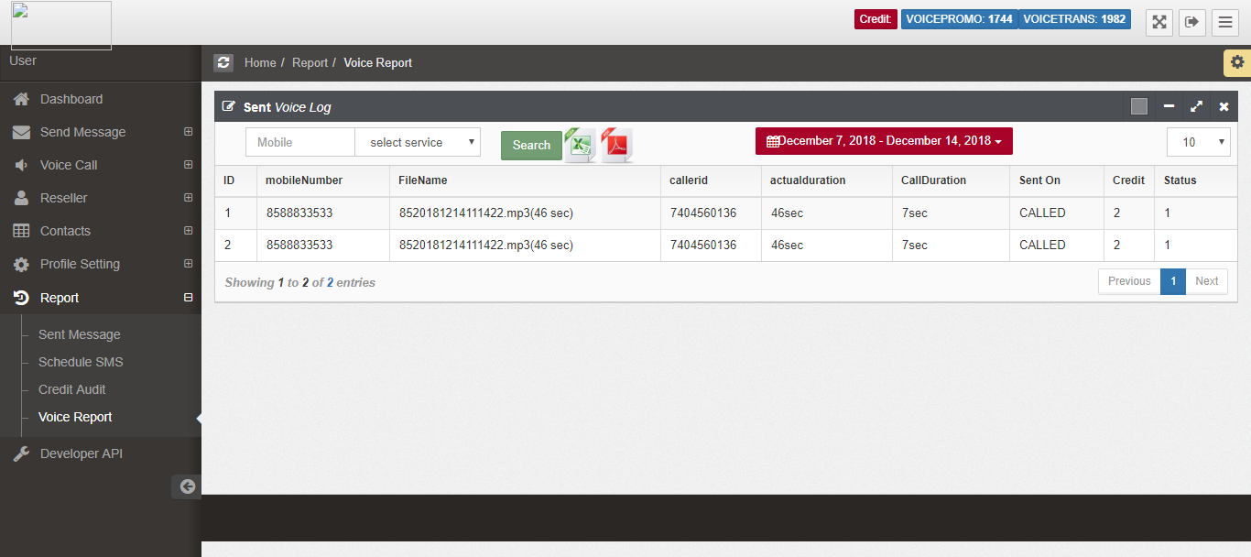
Bonrix Voice Functions
5 : Voice Call Report:

Slide 27
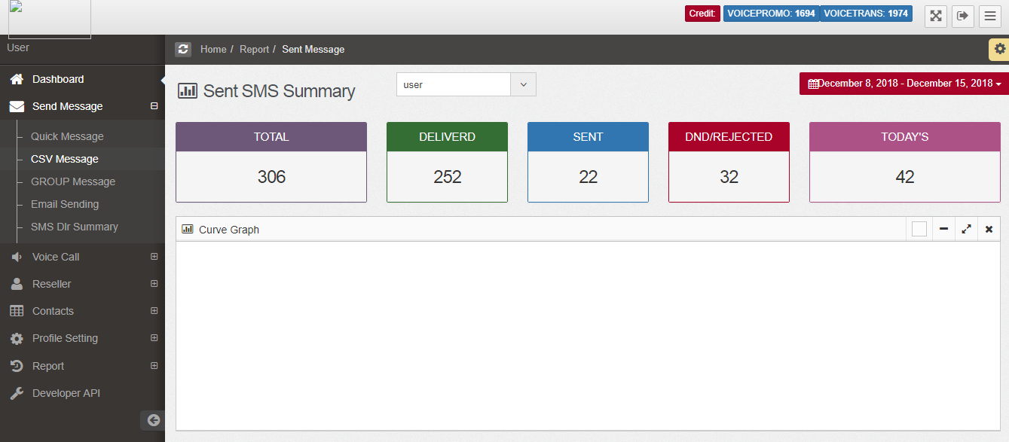
Bonrix Voice Functions
6 : Voice Call Summary:

Slide 28
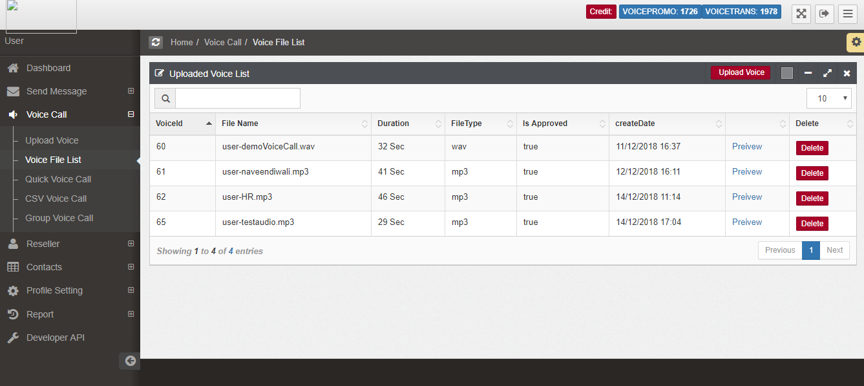
Bonrix Voice Functions
7 : Voice File List:

Slide 29
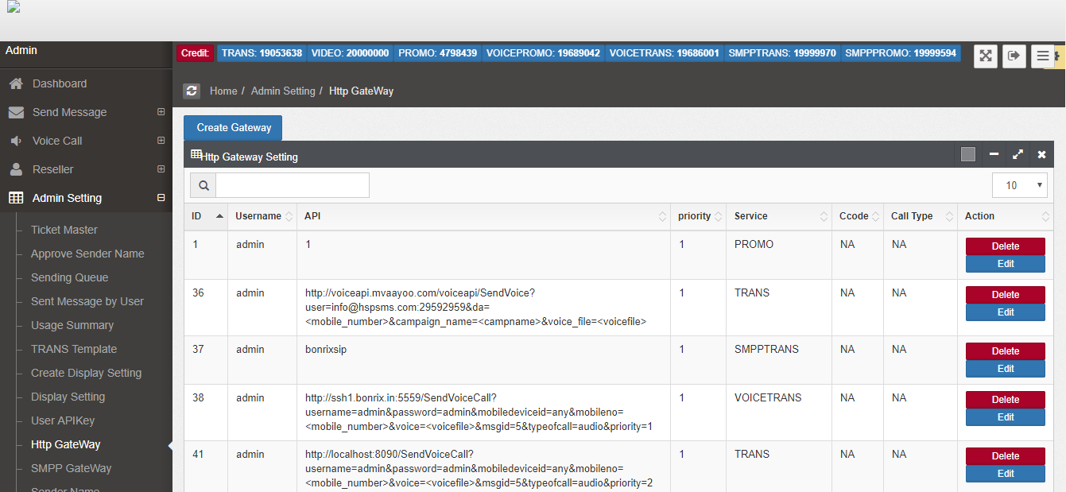
Bonrix Voice Functions
8 : Http API Setting List (Admin Setting):

Slide 30
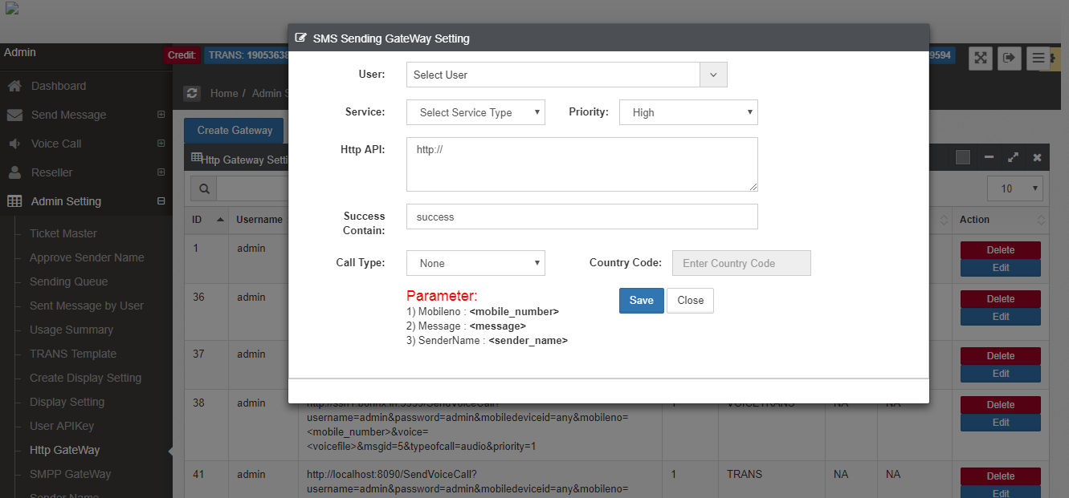
Bonrix Voice Functions
9 : Add Http API Setting (Admin Setting):

Slide 31
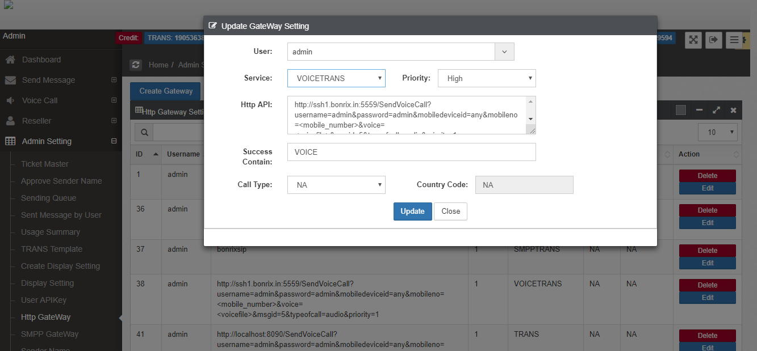
Bonrix Voice Functions
10 : Update Http API Setting (Admin Setting):

Slide 32
Bonrix Voice Functions
Demo Credential
Bonrix Bulk Voice Call User and Reseller Control Panel (BulkVoiceSMS) |  | URL
Login Detail for Admin | Login Id : admin | http://voicesms.mVoicecall.com:8080
 | Password : admin
Login Detail for reseller | Login Id : reseller | http://voicesms.mVoicecall.com:8080
 | Password : reseller
Login Detail for user | Login Id : user | http://voicesms.mVoicecall.com:8080
 | Password : user

Slide 33

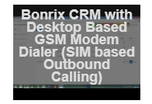

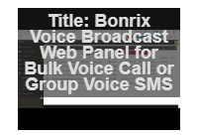
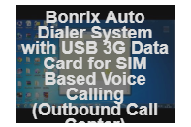
Bonrix’s YouTube video links:
Bonrix SIP Professional Voice Call Manager Bonrix CRM with Desktop Based GSm Modern Dialer / Auto Bulk voice VOIP Dialer (SIM based Outbound calling)
Bonrix Voice Broadcast Web Panel for Bulk Bonrix Auto Dialer System with USB Data Voice Call or Group Voice SMS Card for SIM Based Voice Calling
(Outbound call Center)

Slide 34
Address :
M/S. Bonrix Software Systems
A-801, Samudra Complex,
Near Klassic Gold Hotel, Off. C. G. Road, Navrangpura,
Ahmedabad - 380009, Gujarat, India.
Contact NO :
+91-9429045500,9426045500
Website:
http://www.bonrix.net/ & http://www.bonrix.co.in/
http://mvoicecall.com & http://archive.mvoicecall.com/
Email Id:
bonrix@gmail.com

